Slide 1
APOLOGETICS
IN ONE LESSON
almost
Ai1L.net
Introduction

Slide 2
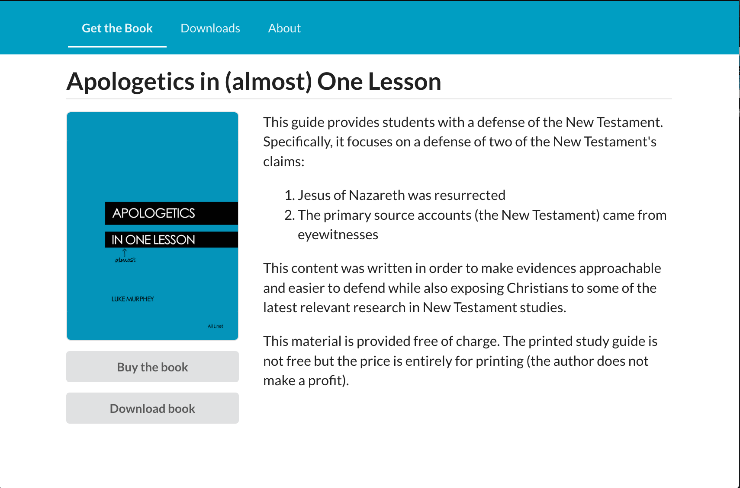
https://Ai1L.net

Slide 3
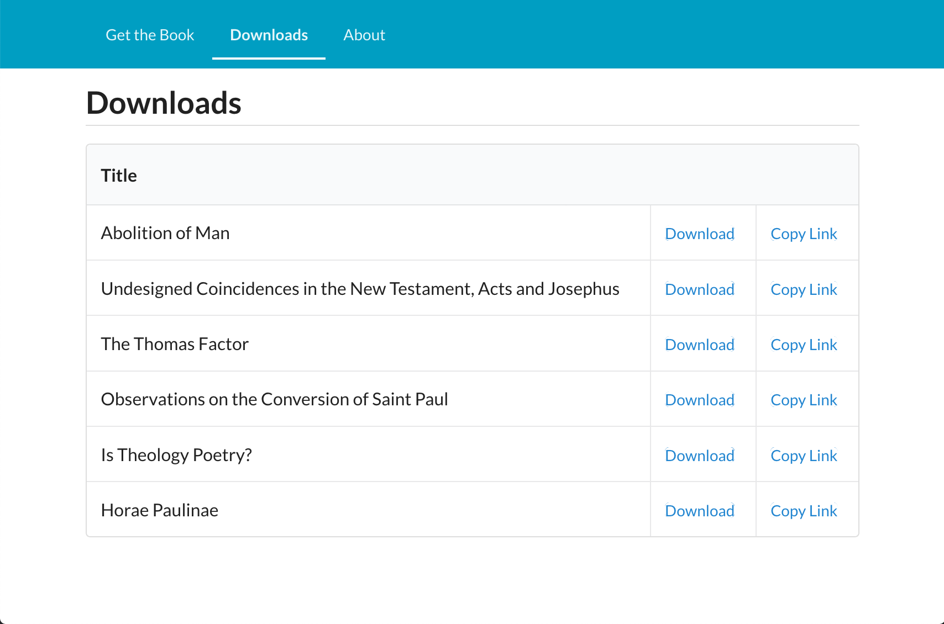

Slide 4
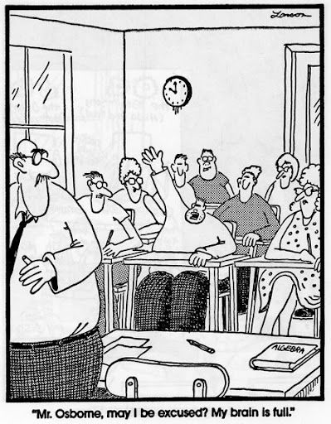

Slide 6
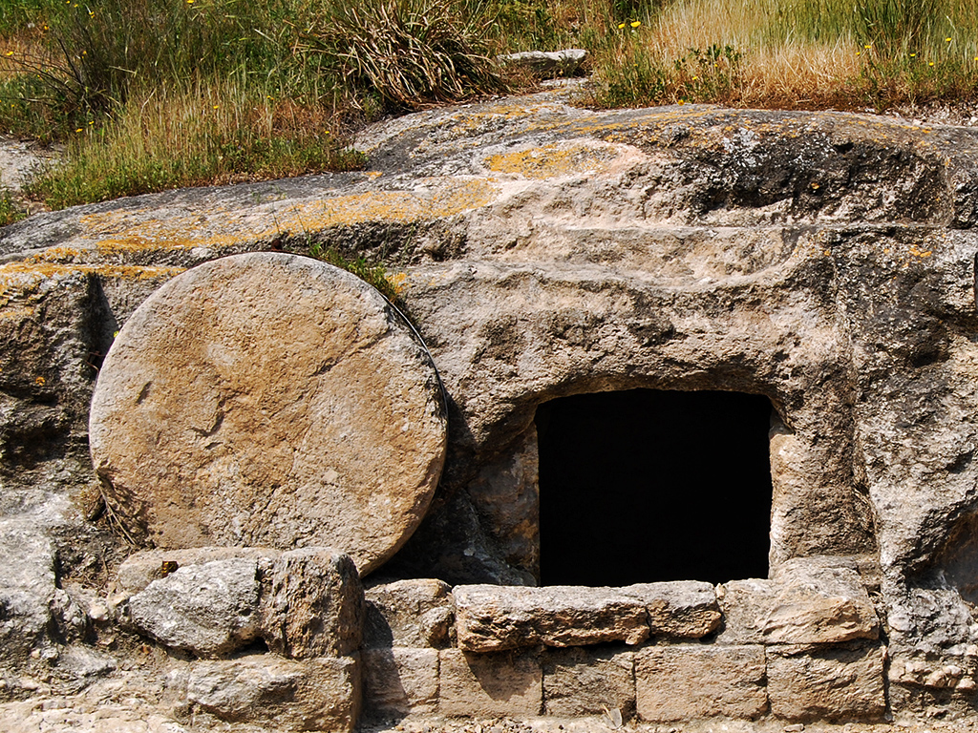
Tomb in Jezreel Valley
Photo by Ferrell Jenkins

Slide 7
Why focus on a defense of the resurrection?
1
Its Biblical
2
Its simpler & easier (since the Gospel is your strength)
3
Helps move the conversations closer to the Gospel
4
Become more knowledgeable in the Gospel accounts

